Slide 1

Zomato Analysis
By Group-4

Slide 2
Agenda
Introduction
Key Features
Visualizations
Summary
Team Members
Presentation Title

Slide 3

Introduction
The Zomato dataset refers to a structured collection of data collected by Zomato from its users, restaurants, and food delivery services. The dataset includes a wide variety of information about restaurants, their performance, user interactions, reviews, ratings, and food preferences. This dataset is often used for analysis and research, particularly to understand customer behaviour, food trends, restaurant success factors, and more.

Slide 4
Key features
Total Restaurants - 9551
Total Countries - 15
Total Cities - 141
Total cuisine’s - 1826
Average ratings - 2.87

Slide 5
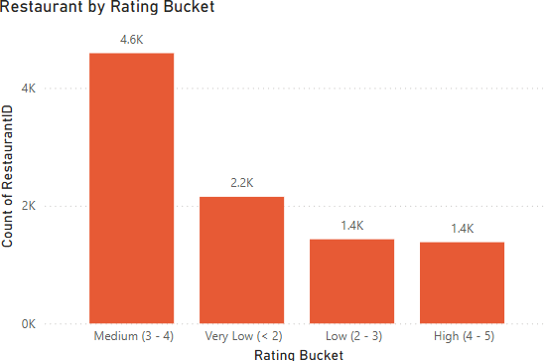
Visualizations
The column chart showcasing restaurants by rating buckets offers a clear visual representation of how restaurants are distributed across different rating categories, using the Zomato dataset. By dividing the ratings into discrete buckets—such as "1-2," "3-4," "4-5," and so on—the chart highlights the concentration of restaurants in each rating range. This allows us to easily see which ratings dominate and where there may be gaps. Conversely, a smaller proportion in the 4-5 range might indicate fewer standout or highly-rated restaurants, potentially pointing to areas for improvement or market opportunities.

Slide 6
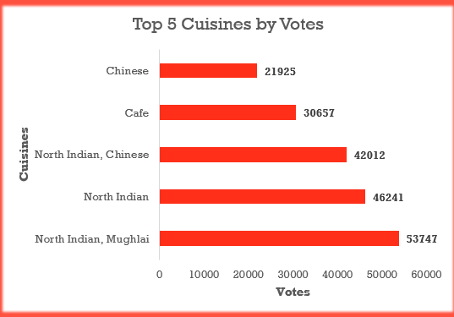
Visualizations
This bar chart showing the top 5 cuisines by votes provides an insightful way to analyze consumer preferences. By visualizing the total number of votes each cuisine receives, the chart highlights the most popular and highly-rated culinary options within the dataset. This analysis can reveal trends, such as certain cuisines garnering more votes due to their versatility or cultural prominence. It can also highlight regional preferences or shifts in dining habits. This data can be used to tailor menus, create targeted promotions, or guide restaurant expansion strategies in areas where certain cuisines are in high demand.

Slide 7
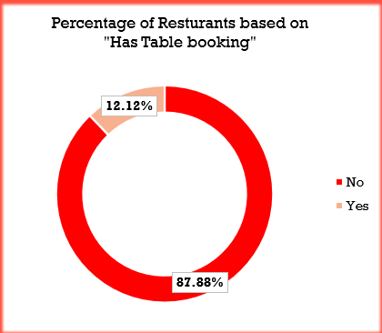
Visualizations
Based on the donut chart showing the percentage of restaurants offering table bookings in the Zomato dataset, it's clear that a significant portion of restaurants are embracing the convenience of reservation systems. The chart illustrates that while a good number of eateries provide the option to book tables in advance, there’s still a noticeable gap, with many establishments not yet adopting this feature. The trend towards reservations can be linked to the increasing demand for convenience and seamless dining experiences.

Slide 8
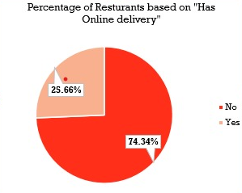
Visualizations
The donut chart showcasing the percentage of restaurants offering online delivery in the Zomato dataset highlights a growing trend toward digital convenience. A large portion of restaurants have adopted online delivery services, indicating the increasing reliance on third-party platforms to reach customers beyond their physical location. This shift reflects a changing dining culture, where convenience and accessibility are key. This data underscores the importance of adapting to modern customer expectations in the competitive restaurant industry.

Slide 9
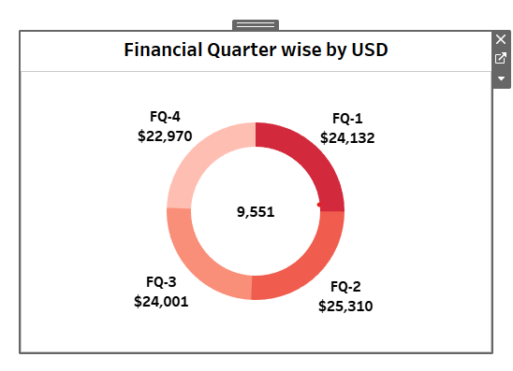
Visualizations
Each segment of the donut represents a quarter’s revenue, with the size of the segment indicating its proportion relative to the others. For example, you may observe that Q2 shows a significant spike, possibly due to increased sales during the holiday season or promotional campaigns. Alternatively, Q4 might reflect a dip, which could be attributed to factors like lower consumer spending in certain months. By examining these patterns, businesses can make informed decisions about budgeting, marketing strategies, and future forecasts.

Slide 10


Summary
The Zomato dataset reveals key trends in the restaurant industry, with most restaurants offering online delivery, highlighting a shift toward convenience. The distribution of ratings shows a competitive market, while customer votes reveal popular cuisines that can guide restaurant offerings. While many restaurants provide table booking, there’s room for growth in this area. Financial data shows seasonal revenue trends, reflecting shifts in consumer behaviour. These insights emphasize the need for restaurants to adapt to customer preferences and stay competitive.

Slide 11







Meet our team
Rishika Harini
Gayathri
Shiva Rama Krishna
Pranav Kumar
Omkar
Yeshwanth
Mayuri

Slide 12




Thank you
Gayathri
Rishika Harini
Pranav Kumar
Omkar
Mayuri
Yeshwanth
Shiva Rama Krishna
Group 4

